Slide 1
Strangers Detection and Tracking System
Faculty of Computer and Information System

Slide 2








01
02
03
04
Ahmed Khalid
Muhammed Ayman
Ahmed Khairullah
Abdullah Mokhtar
ML Engineer
ML Engineer
ML Engineer
Flutter Developer
teams
05
06
07
Ahmed Mohamed
Ibrahim Khairy
Ahmed Khaled
ML Engineer
Cyber Security Engineer
Flutter Developer

Slide 3
INTRODUCTION
As the name of the project suggests, it is designed to detect any attack from outsiders, and the system will issue an alert by sending a notification to the owner or user. The system works to find out if the person is one of the owners of the facility, familiar to them, or represents a danger. Once this is known, the system prevents the attack by detecting the stranger and knowing whether he has a weapon or not.
On the other hand, the system is activelpredefinedy working to prevent an attack from succeeding. If an intrusion is detected, it will respond based on commands. The responses may include blocking the movement of the intruder and sending a notification to the facility owner, and the feature of closing all entrances and exits to the place will be activated automatically

Slide 4
2 STEP FOR PROJECT
01
02
AI MODELS
FLUTTER
IN AI MODEL,WE TRAINED 4 MODELS (FIRE,MASK DETECTION,WEAPON,
FACE RECONIZATION)
IN THIS SIDE WE CREATE APPLICATION FOR CONTROLING THE SYSTEM BY USER

Slide 5
AI MODELS
01
02
03
04
FACE RECONIZATION
Thieves Detection Model
Weapon Detection Model
Fire Detection Model

Slide 6
Collecting Dataset
Video Splitting into Frames
Web Scraping from Selenium Library
06
01
Make Sense for Label
05
Collecting Dataset
02
GitHub
04
03
REPOFLOW WEBSIDE
Kaggle

Slide 7
1 - Face Recognition
Face Recognition Algorithm use distinctive details about a person’s face. These details, such as distance between the eyes or shape of the chin, are then converted into a mathematical representation and compared to data on other faces collected in a face recognition database.
We use VGGFACE2 and MCNN Algorithm to know who is friendly person or stranger , we will show it in some steps :

Slide 8
1 - Face Recognition
Face Detection
01
02
Feature Extraction
03
Face Classification

Slide 9
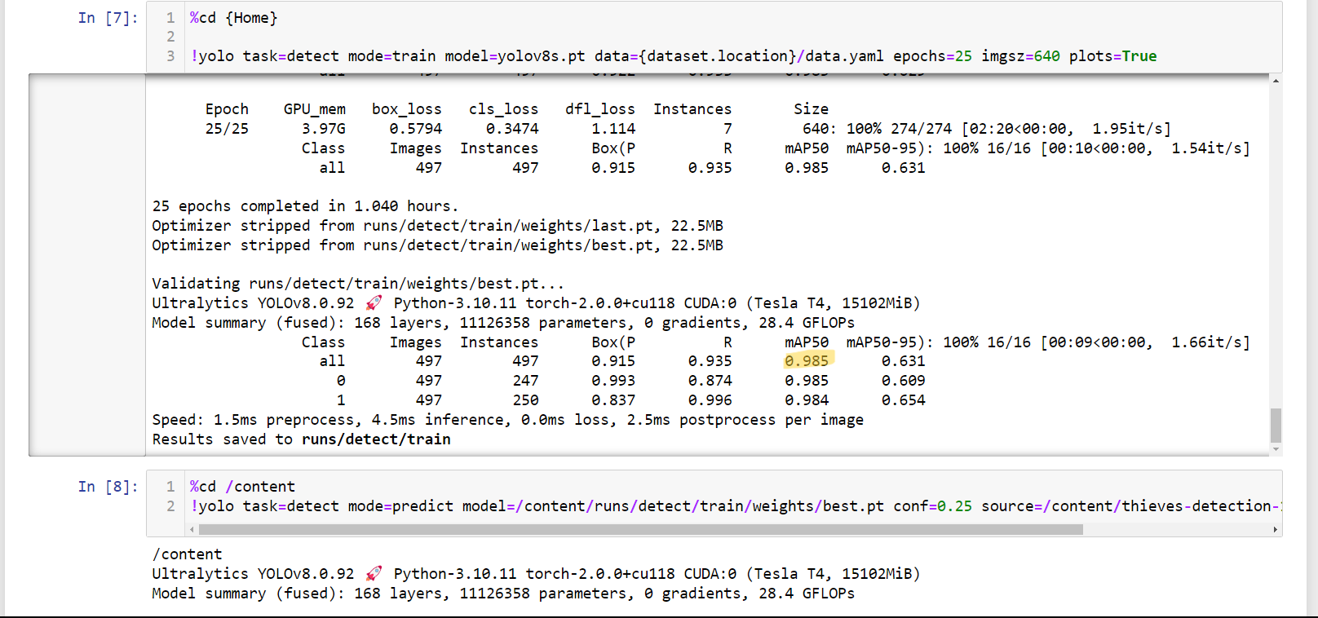
2- Thieves Detection Model

Slide 10
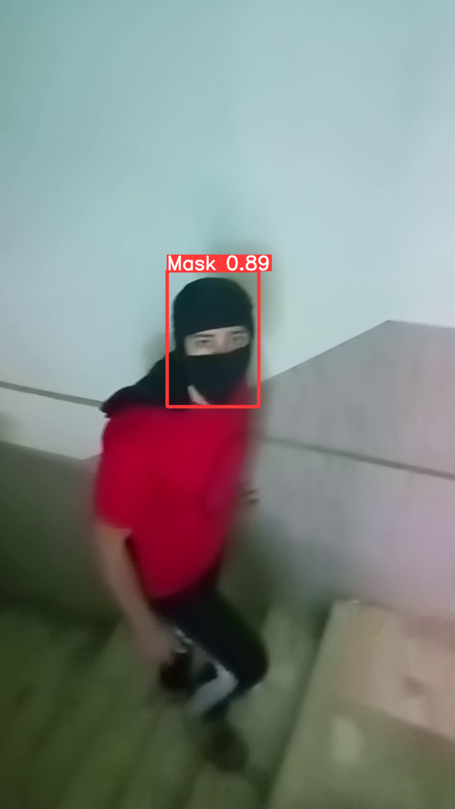
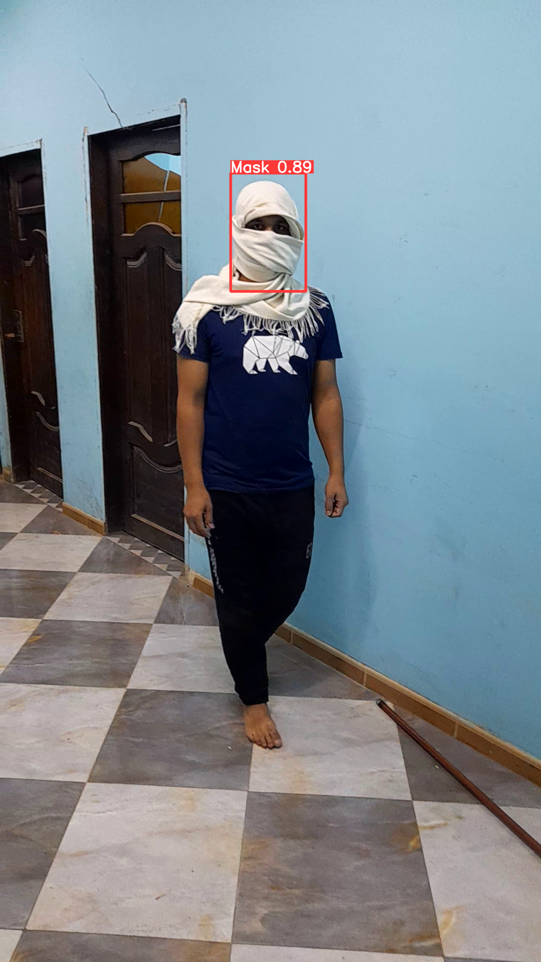
RESULTS
10

Slide 11
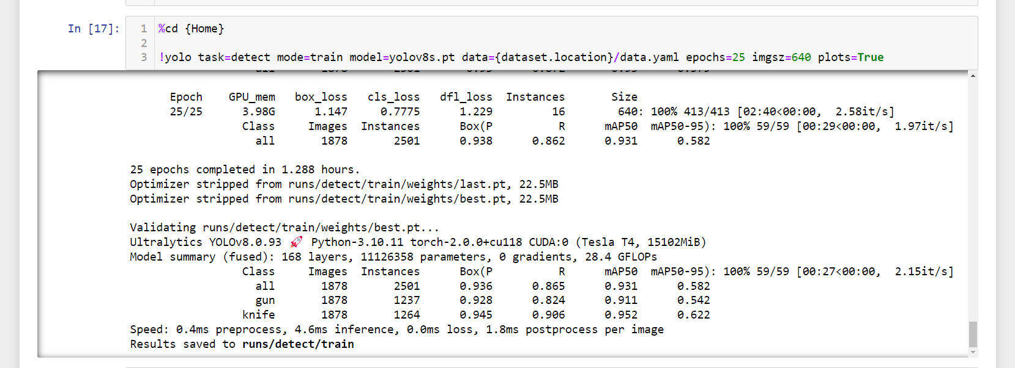
3- Weapon Detection Model

Slide 12
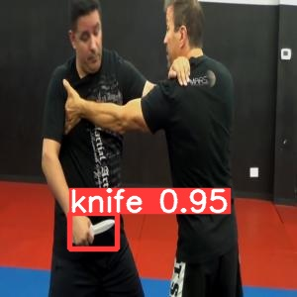
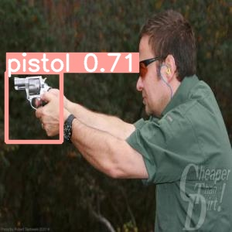
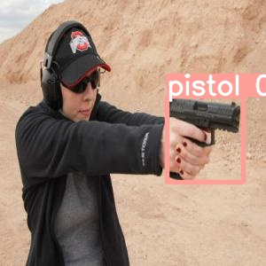
RESULT
12

Slide 13
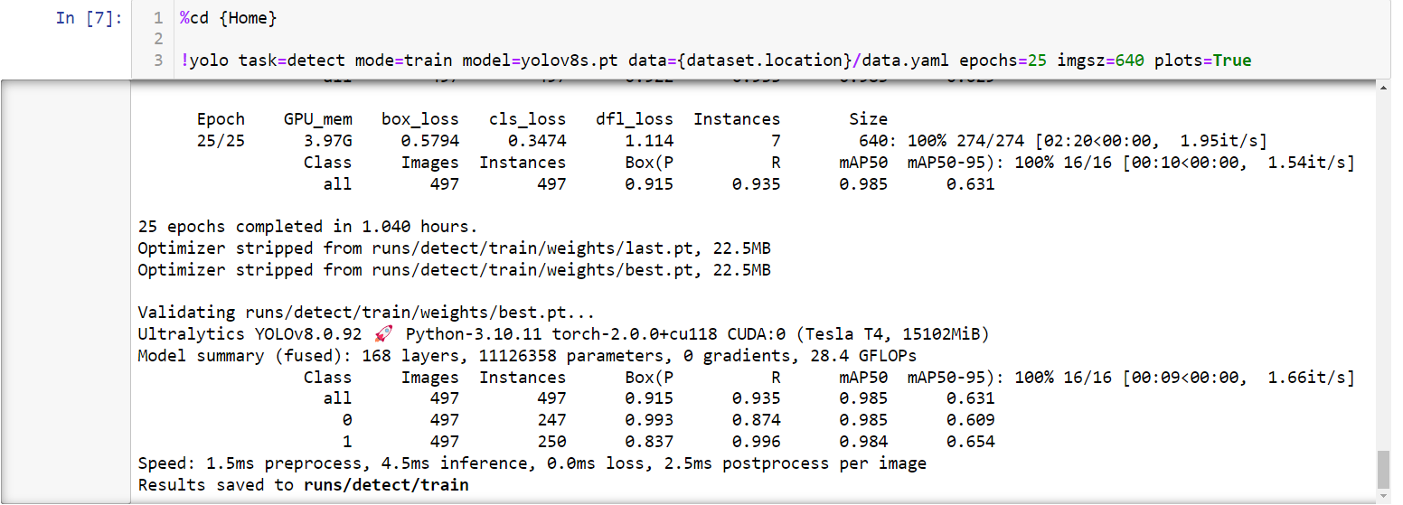
Fire Detection Model

Slide 14
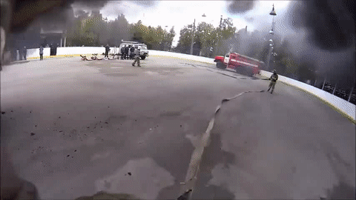
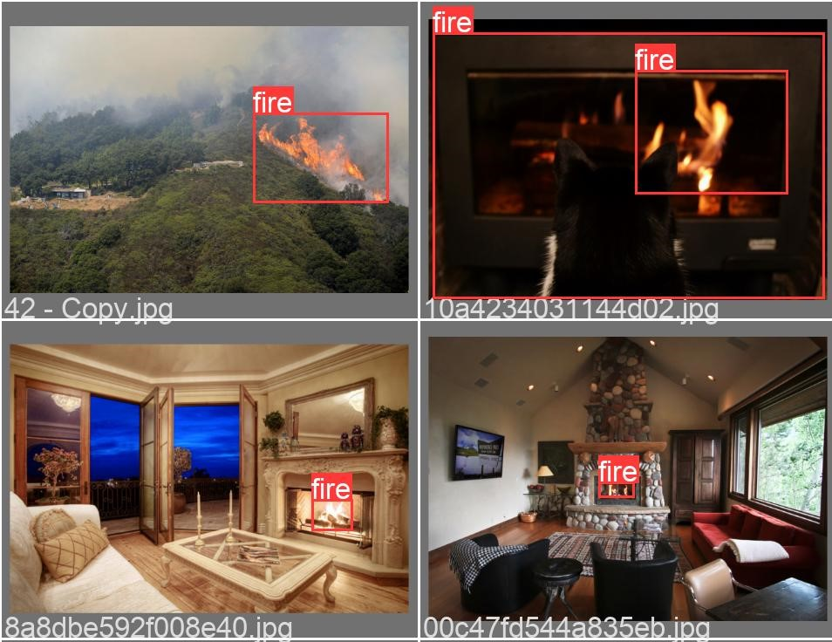
RESULT
14

Slide 15
FLUTTER APPLICATION
CAMERA LIVE
01
02
FAMILY RECONIZATION
03
DAILY REPORTS
04
CLOUD STORAGE
05
NOTIFICATION ALARM

Slide 16
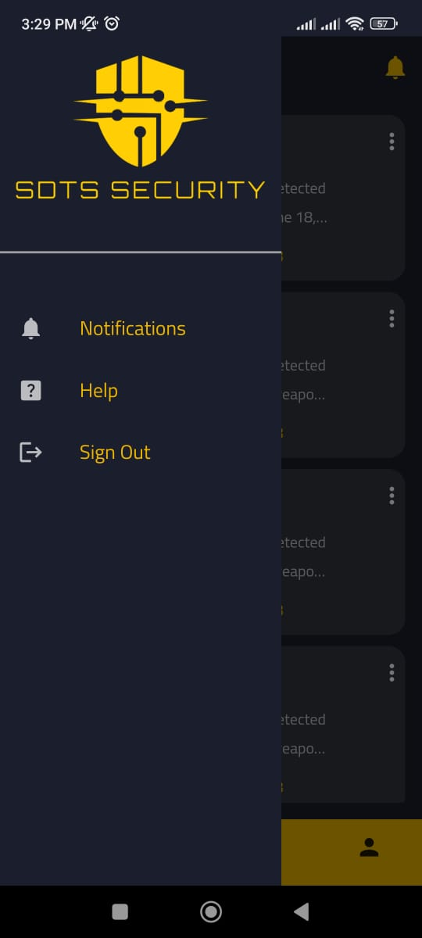
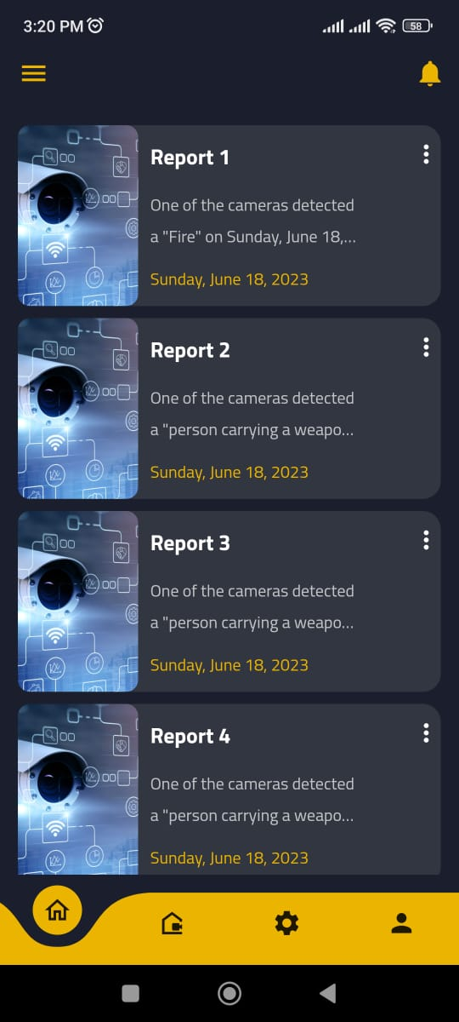
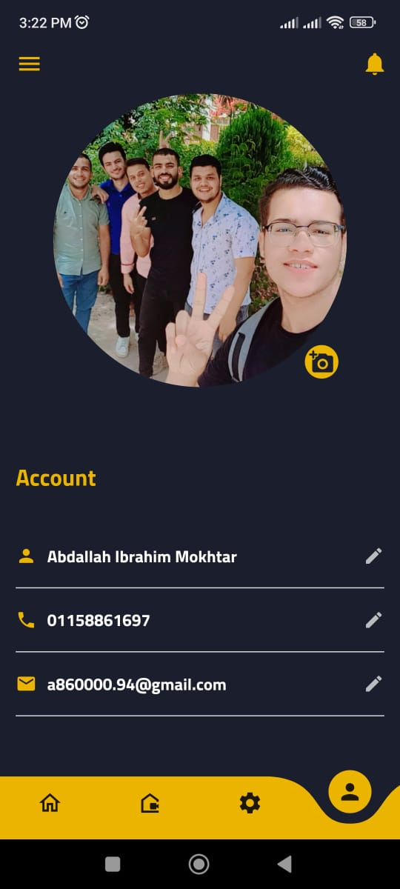
User Interface

Slide 17
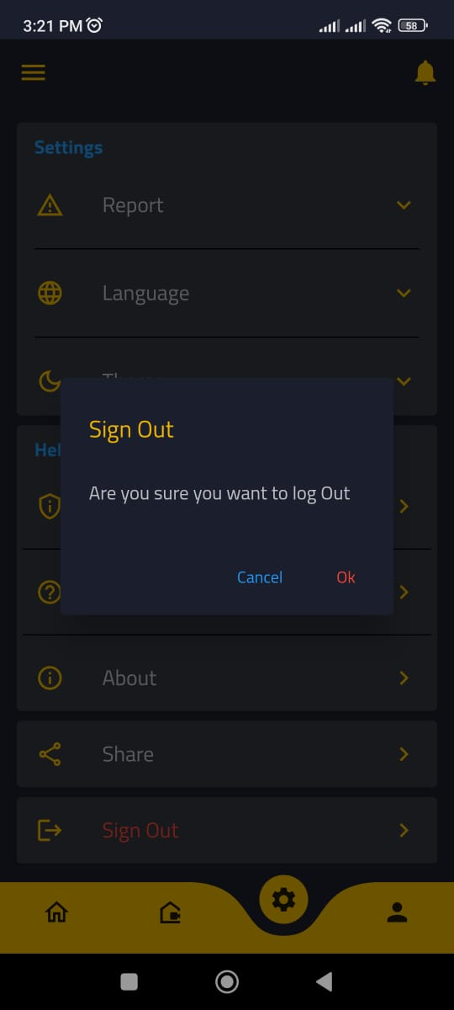
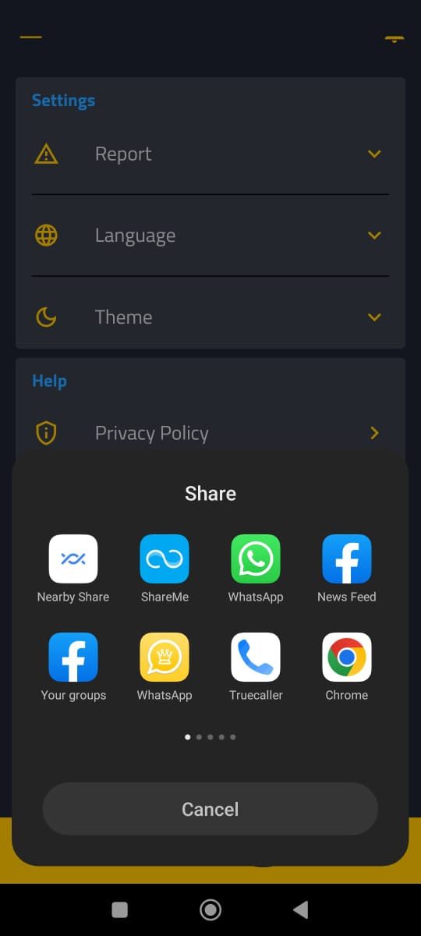
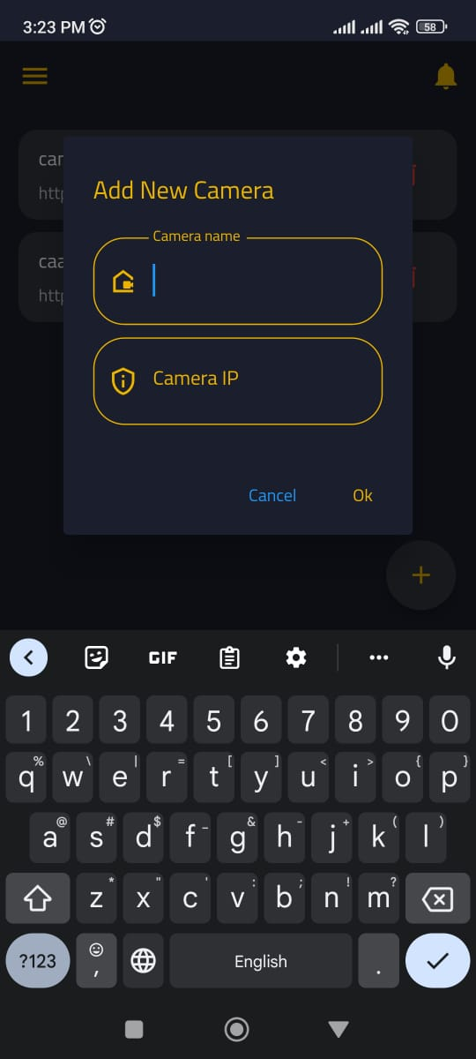
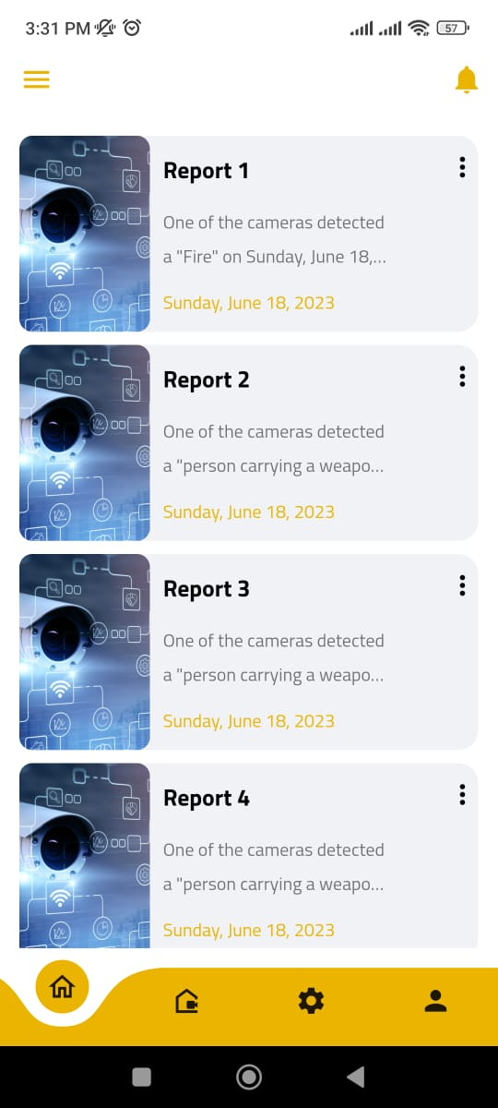
USER INTERFACE

Slide 18
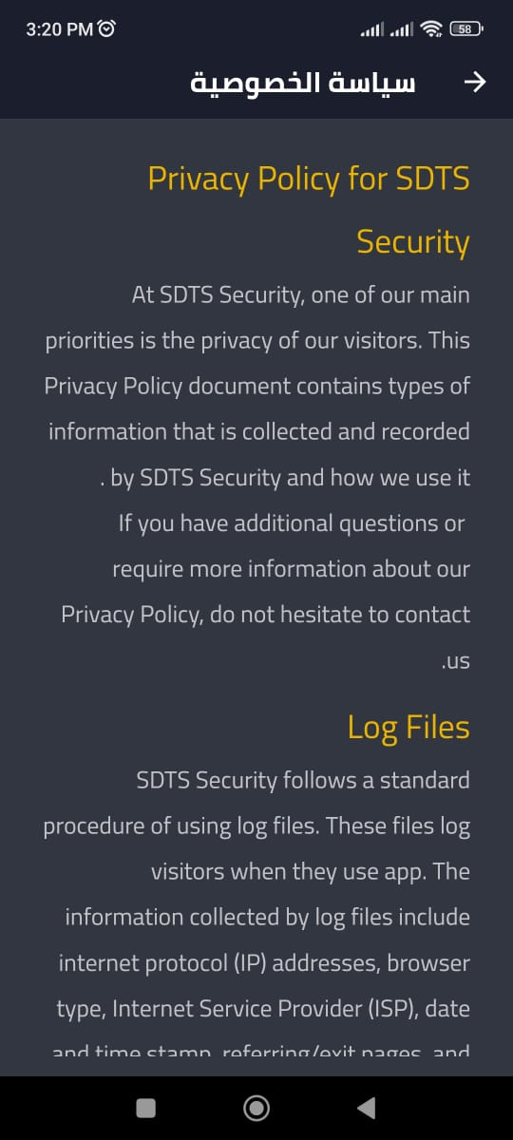
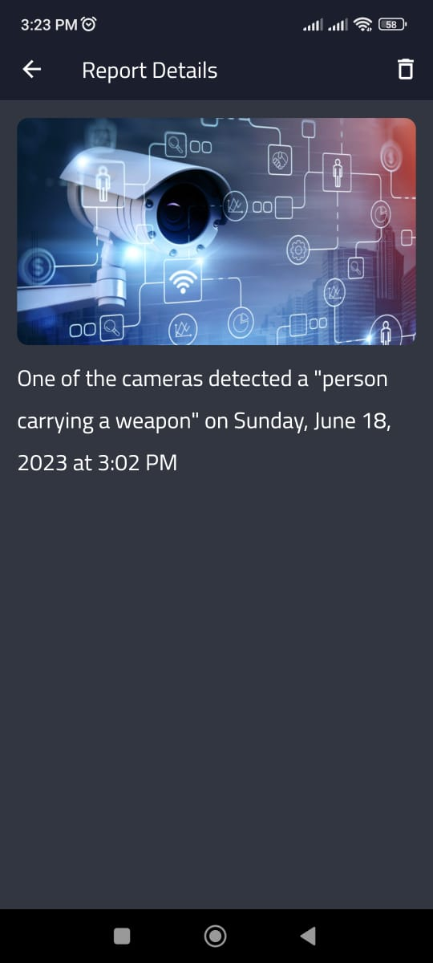
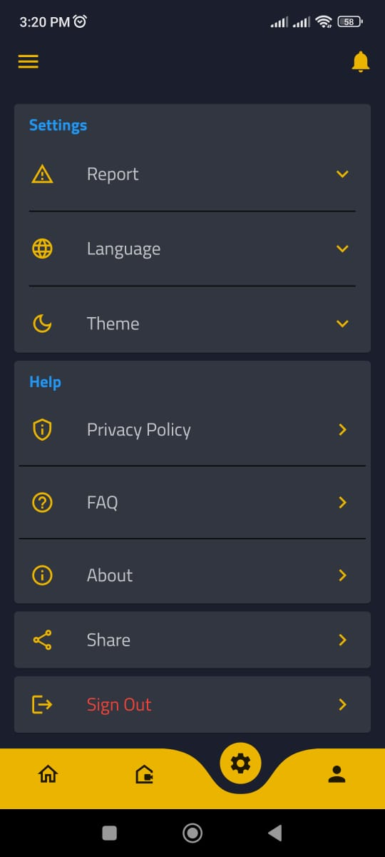
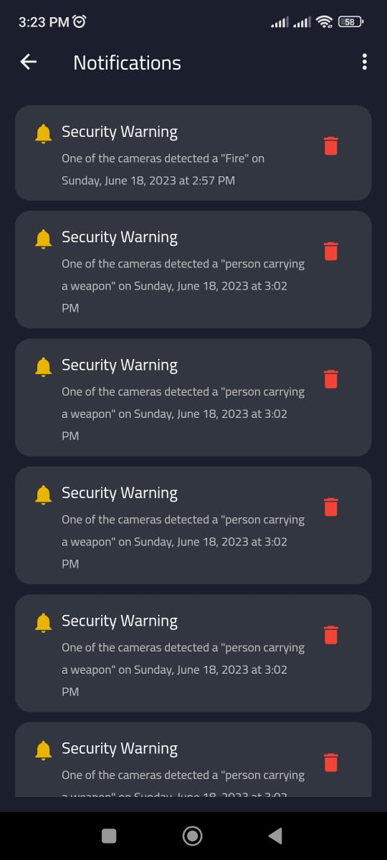
USER INTERFACE

Slide 19
The difference between us and Eufy Scurity
Feature | Our System | Eufy Security
Camera Bundles | ✓ | ✓
Weapon Detect | ✓ | ✗
Storage | ✓ | ✓
Tracking | ✓ | ✗
Recording Resolution | ✓ | ✓
Fire Detect | ✓ | ✗
App Controls | ✓ | ✓
Closing all Entrances and Exits | ✓ | ✗
Facial Recognition Software | ✓ | ✓

Slide 20
THANK YOU

